Slide 1


CSE3150 – Front-end Full Stack Development
School of Computer Science Engineering and Information Science

Slide 2
Module 4 - Syllabus
Introduction to Agile Methodology; Scrum Fundamentals; Scrum Roles, Artifacts and Rituals; DevOps – Architecture, Lifecycle, Workflow & Principles; DevOps Tools Overview – Jenkins, Docker, Kubernetes. Review of GIT source control.

Slide 3
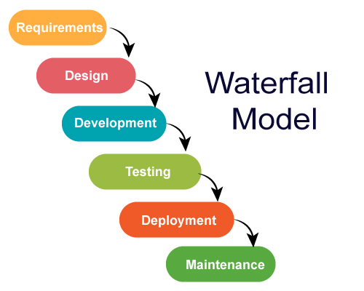
WATER FALL MODEL

Slide 4
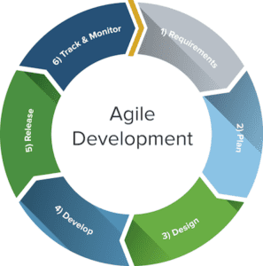
What is the Agile methodology?
Agile methodology is a practice that helps continuous iteration of development and testing in the software development process. In this model, development and testing activities are concurrent, unlike the Waterfall model.
This process allows more communication between customers, developers, managers, and testers.

Slide 5
Waterfall is a Linear Sequential Life Cycle Model, whereas Agile is a continuous iteration of development and testing in the software development process.
Agile performs testing concurrently with software development, whereas in Waterfall methodology, testing comes after the “Build” phase.
Agile allows changes in project development requirements, whereas Waterfall has no scope of changing the requirements once the project development starts.

Slide 6
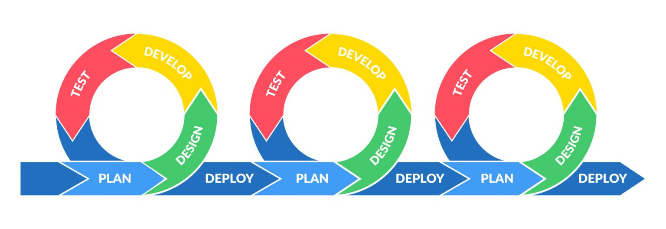
Introduction to Agile Methodology:
Agile is an iterative approach to project management and software development that helps teams deliver value to their customers faster and with fewer headaches.
Instead of betting everything on a "big bang" launch, an agile team delivers work in small, but consumable, increments.
Requirements, plans, and results are evaluated continuously so teams have a natural mechanism for responding to change quickly.

Slide 7

Manifesto for Agile Software Development
We are uncovering better ways of developing software by doing it and helping others do it. Through this work we have come to value:
Individuals and interactions over processes and tools
Working software over comprehensive documentation
Customer collaboration over contract negotiation Responding to change over following a plan
Agile is a Mindset
Ultimately, Agile is a mindset informed by the Agile Manifesto’s values and principles. Those values and principles provide guidance on how to create and respond to change and how to deal with uncertainty.

Slide 8
Principles behind the Agile Manifesto
We follow these principles:
Our highest priority is to satisfy the customer through early and continuous delivery of valuable software.
Welcome changing requirements, even late in development. Agile processes harness change for the customer's competitive advantage.
Deliver working software frequently, from a a couple of weeks to a couple of months, with a preference to the shorter timescale.
Business people and developers must work together daily throughout the project.

Slide 9
Principles behind the Agile Manifesto…………..
Build projects around motivated individuals. Give them the environment and support they need, and trust them to get the job done.
The most efficient and effective method of conveying information to and within a development team is face-to-face conversation.
Working software is the primary measure of progress.
Agile processes promote sustainable development. The sponsors, developers, and users should be able to maintain a constant pace indefinitely.

Slide 10
Pros of Agile Methodology
Flexibility
Collaboration
Customer satisfaction
Continuous improvement
Faster delivery

Slide 11
Cons of Agile Methodology
Implementation challenges
Lack of structure
Difficulty with longer-term planning
Requires a dedicated team
Can lead to scope creep
https://www.youtube.com/watch?v=Z9QbYZh1YXY

Slide 12
Scrum
Scrum is an Agile framework for managing and completing complex projects.
It involves a self-organizing and cross-functional team that works to deliver a usable product incrementally.
"Scrum is an agile process that allows us to focus on delivering the highest business value in the shortest time." - Mike Cohn, Mountain Goat Software
.

Slide 13
Scrum FUNDAMENTALS
1.Empirical Process Control: Scrum is based on the principle of empirical process control, which means that it relies on experience and experimentation to continuously improve the process.
2. Cross-functional Teams: Scrum teams are cross-functional, meaning they consist of individuals with a range of skills and expertise.
3. Sprint: A sprint is a time-boxed period, usually one to four weeks, during which the team works on completing a set of tasks.
4. Incremental Delivery: Scrum allows for the delivery of a usable product increment at the end of each sprint.
5. Transparency: Scrum emphasizes transparency in all aspects of the process, from the work being done by the team to the progress being made.
Notes:
1.

Slide 14
Scrum Methodology
Scrum is simple light weighted agile project management methodology that enables product teams to build products incrementally in an iterative fashion through effective team collaboration.
Scrum forms the base for many of the other frameworks and hence it is important for an agile practitioner to understand this methodology.
The Scrum Methodology is defined by:
Scrum Roles
Scrum Events
Scrum Artifacts
Notes:
1.

Slide 15
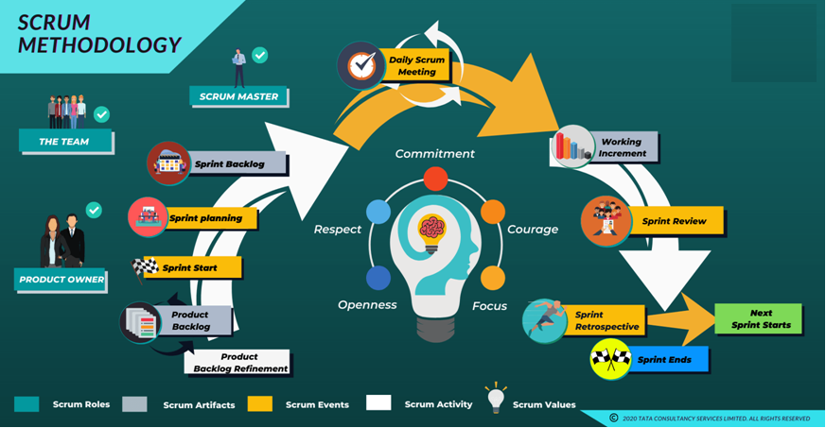
Scrum Methodology
Notes:
1.

Slide 16
What are Scrum Roles?
The scrum team is made up of three roles:
A Product Owner
A Scrum Master
The Development Team.
Notes:
1.

Slide 17
What are Scrum Roles?
1. Product Owner:
A Product Owner in a scrum team decides what needs to be built.
Unlike traditional delivery, this person is a part of the team that delivers the product.
Following are the key responsibilities of the Product Owner:
Creates the vision
Represents business, and is responsible for the ROI
Cascades the vision to the teams
Owns the backlog of features
Prioritizes features by market value
Is empowered to take decisions
Negotiates with the team and business to deliver the right product at the right time
Notes:
1.

Slide 18
What are Scrum Roles?
2. Scrum Master:
The Scrum Master's major responsibility is to ensure that scrum is understood and practiced by every team member in the true spirit.
The following are the key responsibilities of the Scrum Master :
Is a servant leader
Helps remove obstacles
Facilitates collaboration
Teaches scrum to the team.
Protects the teams from external disruptions such as changes to stories in the current sprint.
Notes:
1.

Slide 19
What are Scrum Roles?
3. The Development team:
The Development team in scrum is the team that has all the skills necessary to execute the backlog items.
The following are the special characteristics of 'The Development team':
Self-organizing
Empowered
Cross-functional
Small-sized
Co-located
Committed
Dedicated
Notes:
1.

Slide 20
What are Scrum Artifacts?
Scrum is an Agile framework for managing software development projects. It involves a set of practices and principles designed to help teams deliver high-quality products in a fast and efficient manner.
The following are the three main artifacts in Scrum:
Product Backlog
Sprint Backlog
Increment

Slide 21
Scrum Artifacts
1.Product backlog
A product backlog is a dynamic list of functionalities the product might include, such that it provides value to users.
These are a few unique characteristics of a product backlog:
It is dynamic in nature as it evolves based on changing market needs
Lists all the features and capabilities that will be taken up in iteration and delivered as a product increment
It is refined on a continuous basis. The Product Owner and Development team collaborate and update the details, estimate, and prioritize based on business value and size

Slide 22
Scrum Artifacts
2. Sprint backlog:
Sprint backlog is a subset of the entire product backlog that the scrum team plans to implement in one iteration or sprint.
Sprint backlog has:
Subset of product backlog items that the teams commit to implement in one sprint
Items broken into smaller pieces of work as tasks
A focus on 'HOW' the team does the work and delivers the value in one sprint
A story or task board that is used by the teams to view backlog and what the individuals sign up for work after backlog prioritization
Provision for the Development teams to track the sprint progress and check their alignment with sprint goals

Slide 23
Scrum Artifacts
3. Increment:
An increment is the work delivered at the end of every sprint. Typically, after every iteration there will be a Product Increment (PI) that delivers value and the final product will be a working software.
This increment is a sum of all the capabilities that were delivered in the previous sprints as a part of the PI. At the end of every sprint, the Product Owner decides whether to release the working product increment or wait until the next release.

Slide 24
Scrum
Scrum events and rituals
Events: Events are time-boxed activities with specific agendas and outcomes that must be achieved within the time frame. There are four main events in Scrum: Sprint, Sprint Planning, Daily Scrum, and Sprint Review.
Rituals: Rituals are repeated activities that are performed regularly to reinforce the principles and values of Scrum. Rituals are less formal and less time-boxed than events and do not have specific agendas or outcomes. Examples of Scrum rituals include the product backlog refinement, sprint retrospectives, and product demos.

Slide 25
SCRUM Rituals
Scrum rituals are regular activities that help reinforce the principles and values of
Scrum and improve the development process.
Some of the main Scrum rituals:
Sprint Planning: The team meets to plan the upcoming sprint, review the product backlog, and determine which items can be completed during the sprint. This is a collaborative effort between the development team and the product owner.
Daily Scrum: Also known as the "stand-up," this is a daily meeting where the development team members share updates on their progress and discuss any obstacles they may be facing. The purpose of the Daily Scrum is to increase transparency and accountability within the team.

Slide 26
SCRUM Rituals
Sprint Review: The team meets to review the work completed during the sprint and demonstrate the product increments to stakeholders. This is an opportunity for the team to receive feedback and make improvements for the next sprint.
Sprint Retrospective: The team meets to reflect on the past sprint and identify ways to improve the development process for the next sprint. The Sprint Retrospective is an opportunity for the team to continuously improve and adapt to changing circumstances.
Product Backlog Refinement: The product backlog is regularly reviewed and updated to ensure that it accurately reflects the priorities and goals of the project. This helps to ensure that the team is focused on delivering the most valuable features and functionality to the customer.
https://www.youtube.com/watch?v=m5u0P1WPfvs

Slide 27
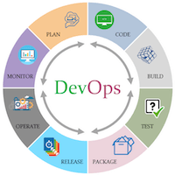
What is DevOps?
DevOps is a combination of two words, one is Software Development, and the second is Operations. This allows a single team to handle the entire application lifecycle, from development to testing, deployment, and operations. DevOps helps you to reduce the disconnection between software developers, quality assurance (QA) engineers, and system administrators.
Various DevOps tools such as Git, Ansible, Docker, Puppet, Jenkins, Chef, Nagios, and Kubernetes.

Slide 28
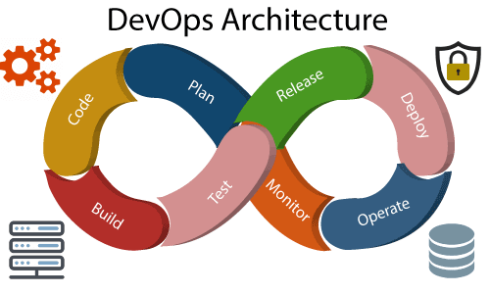
DevOps Architecture
The operation consists of the administrative processes, services, and support for the software. When both the development and operations are combined with collaborating, then the DevOps architecture is the solution to fix the gap between deployment and operation terms; therefore, delivery can be faster.

Slide 29
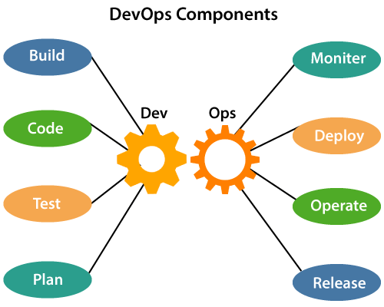
DevOps Architecture
The various components that are used in the DevOps architecture:

Slide 30
DevOps Architecture
The various components that are used in the DevOps architecture:
Build: Cloud and shared resources are used to control resource usage.
Code: Good practices like Git make code use, tracking, and reusability easier.
Test: Automated testing saves time and prepares the app for production.
Plan: Agile methodology helps plan development and improve productivity.
Monitor: Continuous monitoring reduces risk of failure and tracks app health.
Deploy: Automated deployment captures insights and optimizes performance.
Operate: DevOps collaborates throughout the service lifecycle.
Release: Deployment to production is done manually to minimize impact.

Slide 31
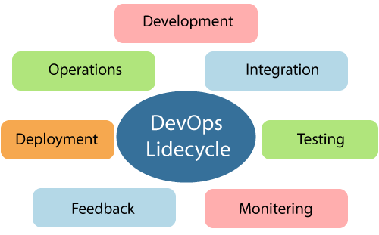
DevOps Lifecycle
DevOps defines an agile relationship between operations and Development. It is a process that is practiced by the development team and operational engineers together from the beginning to the final stage of the product

Slide 32
DevOps Lifecycle
The DevOps lifecycle consists of seven phases: Continuous Development, Continuous Integration, Continuous Testing, Continuous Monitoring, Continuous Feedback, Continuous Deployment, and Continuous Operations. Each phase plays a crucial role in the software development process and contributes to the overall efficiency and effectiveness of the DevOps approach.
Continuous Development, involves planning and coding the software where the vision of the project is decided and the developers begin coding the application.
Continuous Integration is the heart of the DevOps lifecycle and involves committing changes to the source code frequently and building the code, including unit testing, integration testing, code review, and packaging.
Continuous Testing involves constantly testing the developed software for bugs using automation testing tools such as TestNG, JUnit, and Selenium.

Slide 33
DevOps Lifecycle contd..
Continuous Monitoring involves monitoring the operational factors of the DevOps process and recording important information about the use of the software.
Continuous Feedback involves analyzing the results from the operations of the software to continuously improve the application development. Continuous Deployment involves deploying the code to the production servers and ensuring that the code is correctly used on all servers. Configuration management tools play a crucial role in executing tasks frequently and quickly in this phase.
Continuous Operations are based on continuity with complete automation of the release process and allow organizations to accelerate the overall time to market. With DevOps, the software product becomes more efficient and increases the overall count of interested customers.

Slide 34
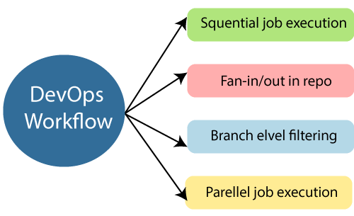
DevOps Workflow
DevOps workflow provides a visual overview of the sequence in which input is provided. Also, it tells about which one action is performed, and output is generated for an operations process
DevOps workflow allows the ability to separate and arrange the jobs which are top requested by the users. Also, it gives the ability to mirror their ideal process in the configuration jobs.

Slide 35
DevOps Principles
The main principles of DevOps are Continuous delivery, automation, and fast reaction to feedback.
End to End Responsibility
Continuous Improvement
Automate Everything
Custom Centric Action
Monitor and test everything
Work as one team

Slide 36
DevOps Tools
Docker
Docker is a high-end DevOps tool that allows building, ship, and run distributed applications on multiple systems. It also helps to assemble the apps quickly from the components, and it is typically suitable for container management.
Features
It configures the system more comfortably and faster.
It increases productivity.
It provides containers that are used to run the application in an isolated environment.
It routes the incoming request for published ports on available nodes to an active container. This feature enables the connection even if there is no task running on the node.
It allows saving secrets in the swarm itself.

Slide 37
DevOps Tools
Jenkins
Jenkins is a DevOps tool for monitoring the execution of repeated tasks. Jenkins is a software that allows continuous integration. Jenkins will be installed on a server where the central build will take place. It helps to integrate project changes more efficiently by finding the issues quickly
Features
Jenkins increases the scale of automation.
It can easily set up and configure via a web interface.
It can distribute the tasks across multiple machines, thereby increasing concurrency.
It supports continuous integration and continuous delivery.
It offers 400 plugins to support the building and testing any project virtually.
It requires little maintenance and has a built-in GUI tool for easy updates.

Slide 38
DevOps Tools
Kubernetes
Kubernetes is a powerful and feature-rich platform for managing containerized applications
Features
Container orchestration: Kubernetes provides a platform for deploying, scaling, and managing containers, making it easier to manage and scale applications.
Self-healing: Kubernetes has built-in mechanisms for automatically replacing failed containers, ensuring that applications remain available and running even in the face of failures.
Automatic scaling: Kubernetes can automatically scale the number of containers running based on demand, providing a way to ensure that applications can handle increased traffic and load.
Load balancing: Kubernetes provides built-in load balancing capabilities, making it easy to distribute incoming traffic across multiple containers.

Slide 39
DevOps Tools
Kubernetes contd..
Kubernetes is a powerful and feature-rich platform for managing containerized applications
Features
Configuration management: Kubernetes provides a way to manage the configuration of containers, making it easier to deploy and manage applications at scale.
Secret and configuration management: Kubernetes provides a secure way to manage secrets and configuration data, helping to ensure that sensitive information is kept secure.
Resource management: Kubernetes provides a way to manage the resources required by containers, including CPU, memory, and storage. This helps to ensure that applications get the resources they need to run effectively.
Rollouts and rollbacks: Kubernetes provides a way to easily perform rolling updates and rollbacks of applications, making it easier to manage the deployment of updates.
Batch processing: Kubernetes provides a platform for running batch processing jobs, making it a great choice for organizations that need to process large amounts of data.
Service discovery: Kubernetes provides a way to discover and access services running within the cluster, making it easier to build distributed applications.

Slide 40
What Is Source Control?
Source control, also known as version control, is a system for managing changes to a codebase or other collection of files over time. It provides a way to track the history of changes made to the code, making it easier to manage and collaborate on software development projects.
Source Control vs. Version Control
These two terms are used interchangeably. However, source control is specific to source code. Version control also covers large binary files and digital assets.

Slide 41
Source Control Features
Features
Versioning
Branching and Merging
Collaboration
Conflict resolution
Continuous integration and delivery
Auditing
Security

Slide 42
What Is Source Control Management?
Source control management (SCM) refers to tools that help you keep track of your code with a complete history of changes.
Source control tools include:
Git -Git is a popular open-source version control system that allows multiple users to collaborate and manage changes to software projects efficiently. It enables teams to track changes and work together in real-time, making it a crucial tool for DevOps.
Helix Core
Subversion
ClearCase
Team Foundation Server
Mercurial

Slide 43
Review of GIT source control.
Speed: Git is designed to be fast, even when working with large projects or repositories. It uses a unique data structure called a "packfile" to efficiently store and retrieve version control data.
Easy Collaboration: Git allows multiple developers to work on the same project simultaneously.
Security: Git provides robust security features, including cryptographic hashing and digital signatures to secure version control data.
Large Community: Git has a large and active community of developers who contribute to the project and provide support.
Git is a widely used open-source distributed version control system that helps track changes made to software source code. It was created by Linus Torvalds in 2005 and has since become one of the most popular version control systems in use today.
Git offers a number of benefits over other version control systems, including:
Distributed Architecture.
Branching and Merging.

Slide 44
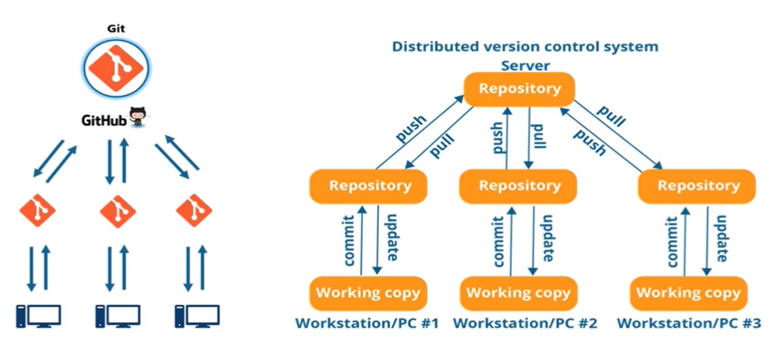

Slide 45
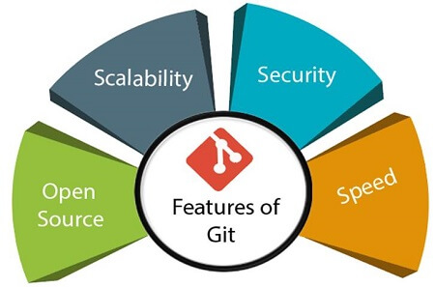
Features of Git

Slide 46
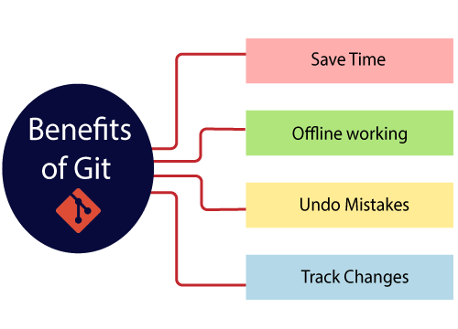
Benefits of Git

Slide 47
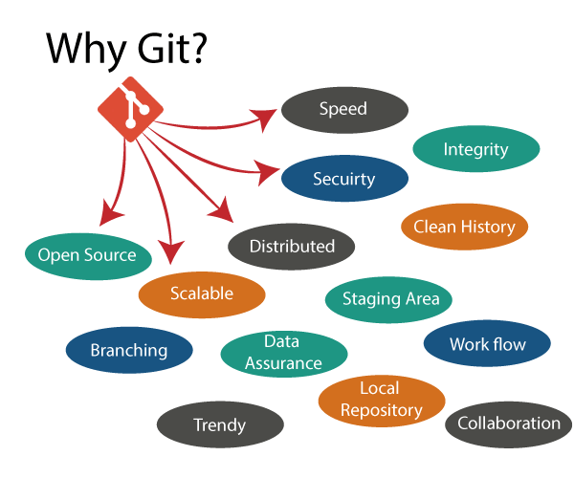
Why Git?

Slide 48
Branching and Merging
Create a separate branch for a new module of the project, commit and delete it whenever we want.
production branch, which always has what goes into production and can be merged for testing in the test branch.

Slide 49
Branching and Merging (Continue)
create a demo branch for the experiment and check if it is working. Remove it if needed.
The core benefit of branching is if we want to push something to a remote repository, we do not have to push all of our branches. We can select a few of our branches, or all of them together.

Slide 50
Deploying an Angular/React App & UnitTesting in Angular
Modern web applications require efficient deployment strategies for performance and scalability.
Angular and React provide optimized build processes for production deployment.
Hosting options range from static hosting services (Netlify, Vercel, GitHub Pages) to server-based deployment (AWS, Nginx).
Unit testing in Angular ensures code reliability using Jasmine (testing framework) and Karma (test runner).
Automated testing and CI/CD pipelines streamline deployment and quality assurance.

Slide 51
Deploying an Angular App
- Build Process:
Run `ng build --prod`
Output in `dist/`
Deployment Options:
Firebase, AWS S3, Netlify, Vercel, GitHub Pages
Server Deployment:
Nginx, Apache, Node.js server
- CI/CD Integration:
GitHub Actions, Jenkins

Slide 52
Deploying a React App
- Build Process:
Run `npm run build`
Output in `build/`
- Deployment Options:
Vercel, Netlify, GitHub Pages, Firebase
- Server Hosting:
Express.js (Node.js), Nginx
- CI/CD Integration:
GitHub Actions, Travis CI

Slide 53
Unit Testing in Angular (Jasmine & Karma)
- Testing Frameworks:
• Jasmine: Behavior-driven testing framework
• Karma: Test runner for unit tests
- Setting Up:
• Run `ng test`
• Configure `karma.conf.js`

Slide 54
Writing a Basic Unit Test in Angular
```typescript
import { TestBed } from '@angular/core/testing';
import { AppComponent } from './app.component';
describe('AppComponent', () => {
beforeEach(() => {
TestBed.configureTestingModule({
declarations: [AppComponent],
});
});

Slide 55
Contd..Writing a Basic Unit Test in Angular
it('should create the app', () => {
const fixture = TestBed.createComponent(AppComponent);
const app = fixture.componentInstance;
expect(app).toBeTruthy();
});
});
```

Slide 56
Running and Debugging Tests
- Running Tests:
• `ng test` – Runs tests in watch mode
• `ng test --code-coverage` – Generates a coverage report
- Debugging Tips:
• Use Chrome DevTools
• Run with `--browsers Chrome`
• Add `console.log()` for debugging

Slide 57


